Slide 1

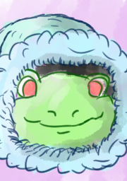
Project Neo-Pong
Team 3Suqare

Slide 2
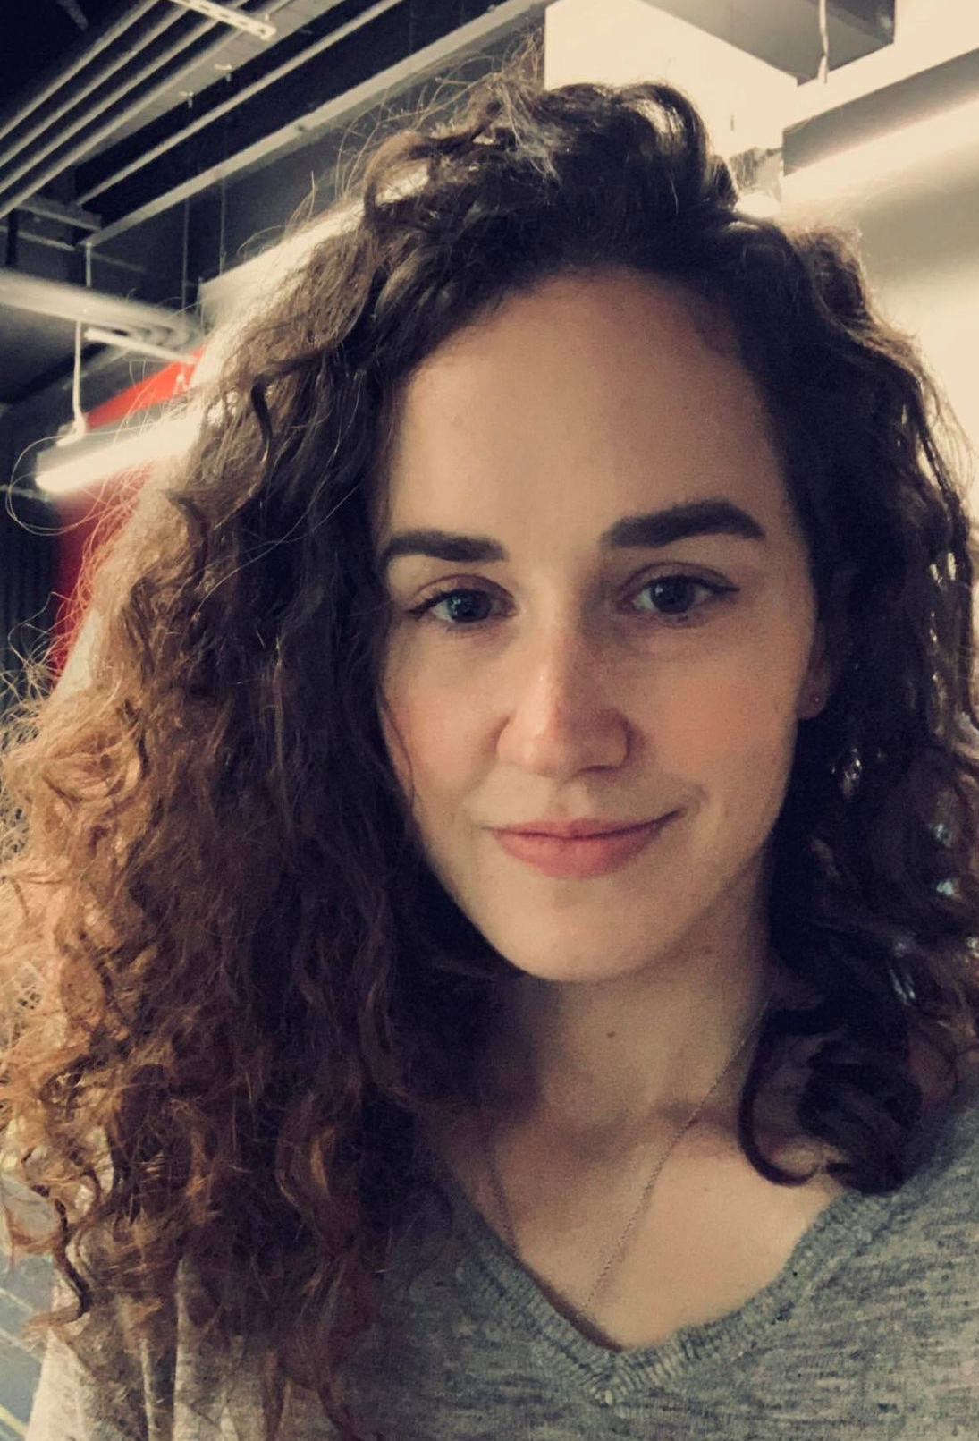
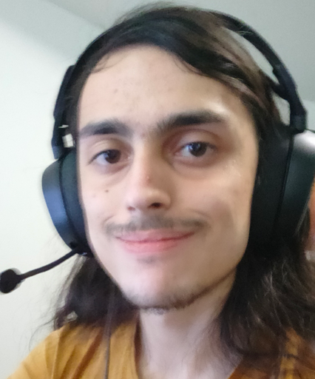
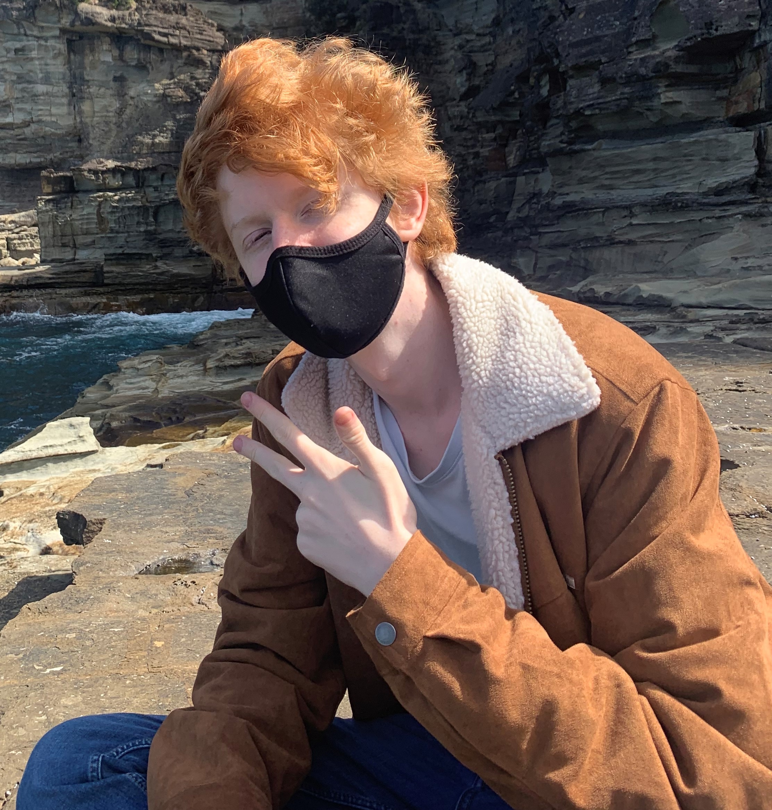
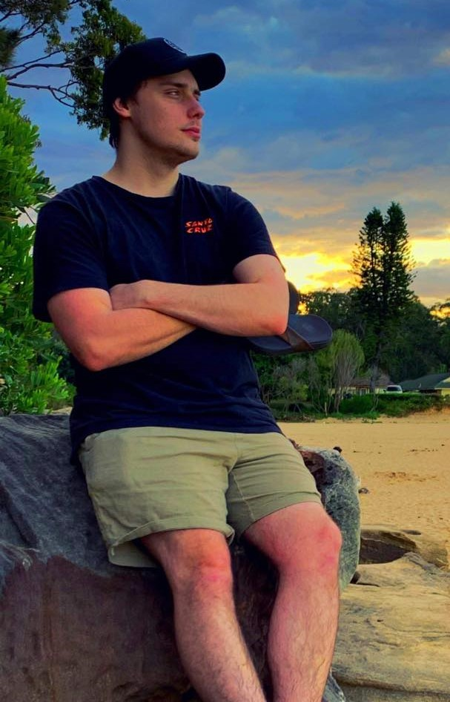
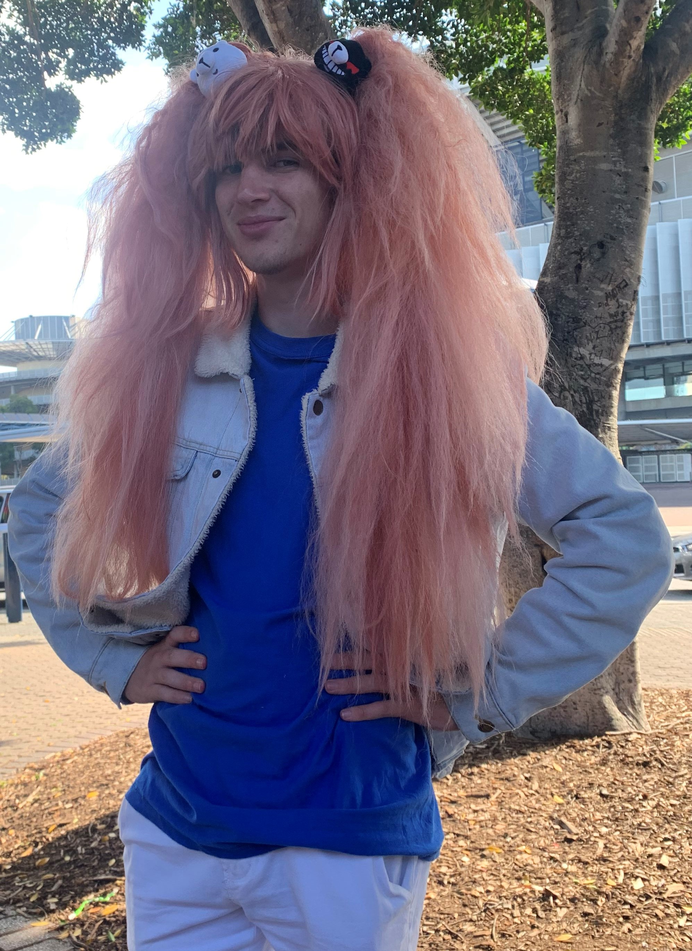
The Team: Team 3Suqare
Roles and Responsibilities
Person 1 | Person 2 | Person 3 | Person 4 | Person 5
Anna Ross | Cody Smith | Daniel Sohler | Benjamin Scott | Joshua Spence
3D Artist | 3D Artist | Designer | Programmer | Designer

Slide 3
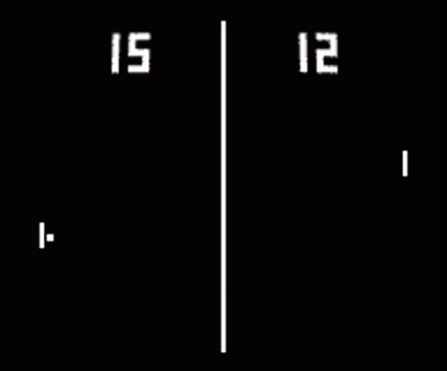
Key project objectives
After reviewing the client brief, our focus was on:
Paddle on ball action
Competitive
Simplistic/Easy to pick up
Target Audience
Suitable for all ages
Market Research
Keep it simple

Slide 4

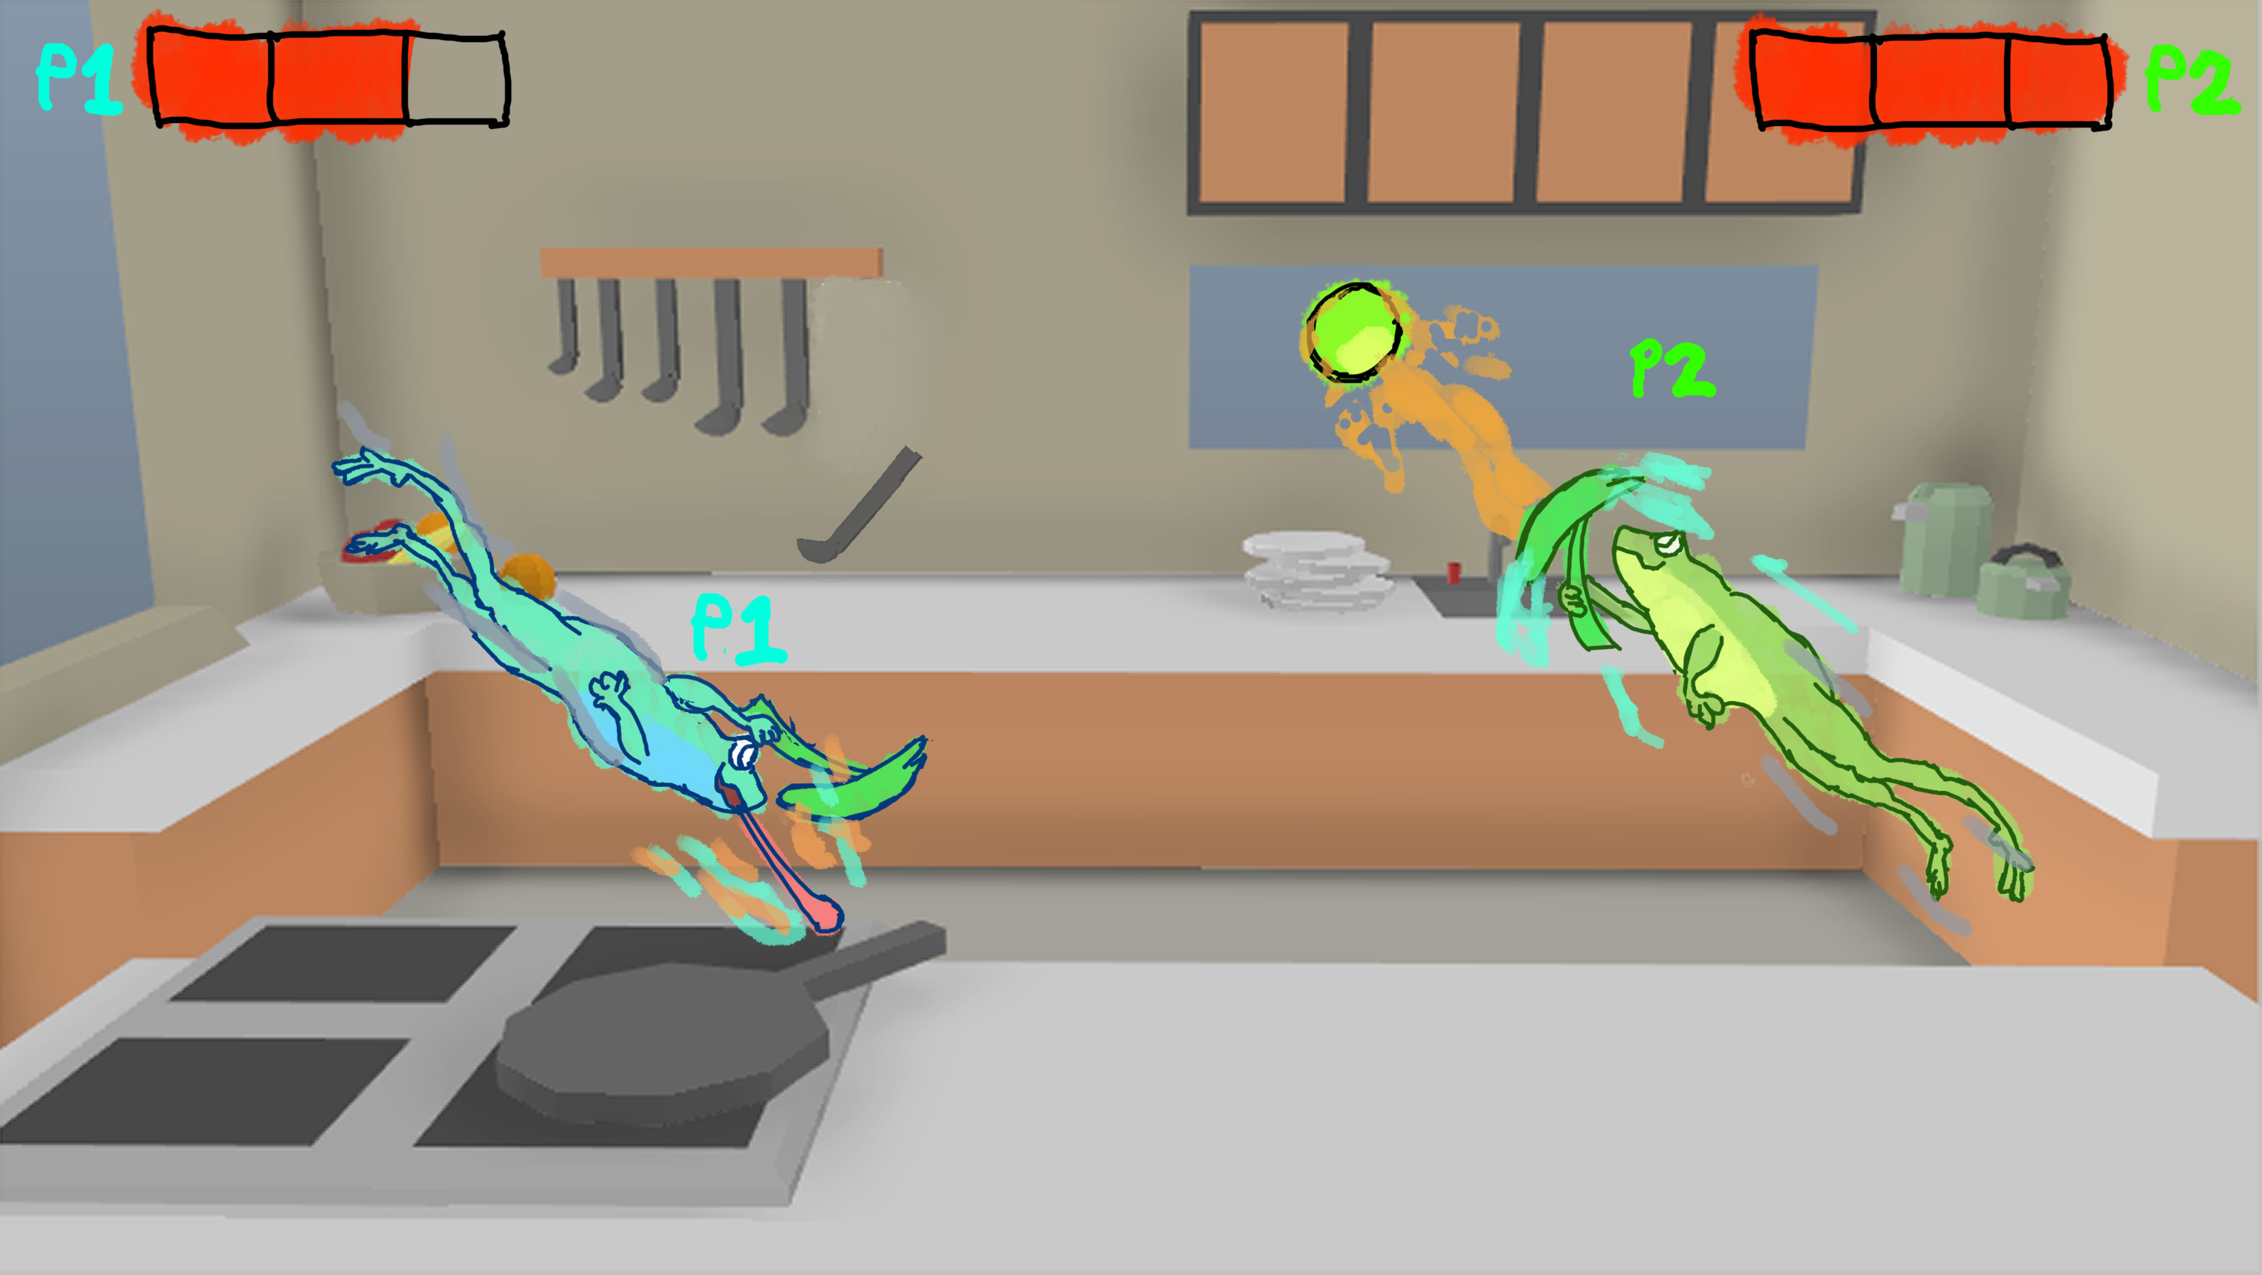
Pond Chicken
Pond Chicken is a game of last man standing. Players take control of a frog and must try to avoid getting hit while hitting the other player with the pea. Dodge and deflect your way to victory!
Constant action
Vibrant world
Chaotic, everchanging situation
There are no chickens

Slide 5
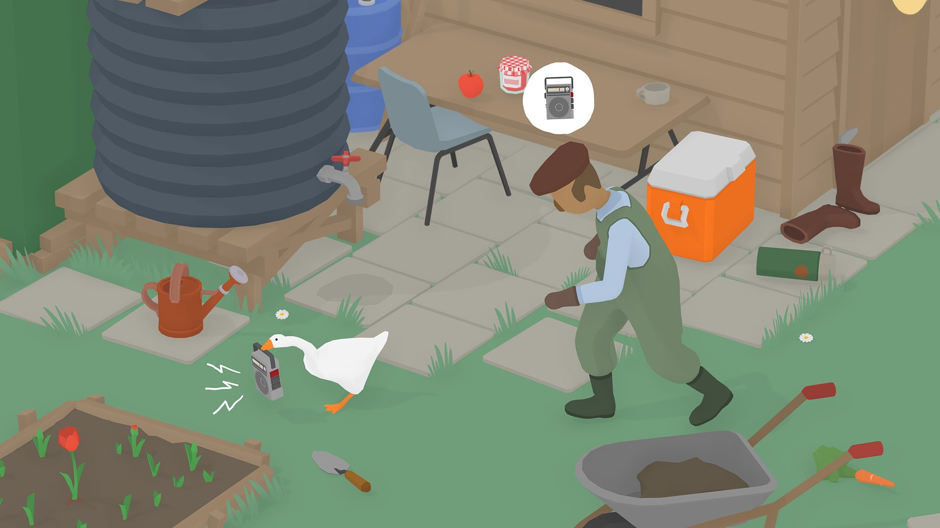
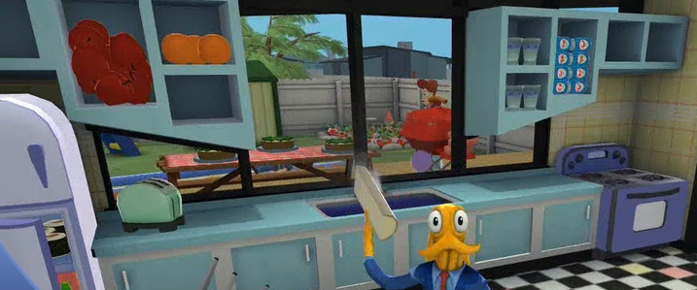
Pond Chicken – Art direction
Art style/influences - Very stylized, cartoon style. Tight and responsive animation, 2D flat-shaded art for VFX (i.e. dash effect)
Concept art proposed for environment / character / props
Colour palette – bright colours, high saturation, eye-catching
Art tools software – Maya, Zbrush, Substance Painter/Designer, In-engine lighting

Slide 6
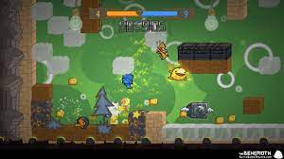
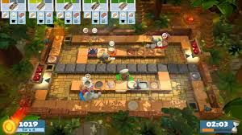
Pond Chicken – Game design
Gameplay Pillars
Chaotic Gameplay/Quick to play/Competitive
Gameplay Features
Always moving/ Paddle Management
Air-dashing as primary movement
Gameplay Systems
3 Lives/Gravity/Ball/Walls/Score

Slide 7
Pond Chicken – Technical Information
Engine
Unity
Platform
Web
Technical Challenge
Custom physics system for the character controller
Ball physics
Scoring system
Jump animation/rigging
Collisions
Maintaining framerate for web

Slide 8


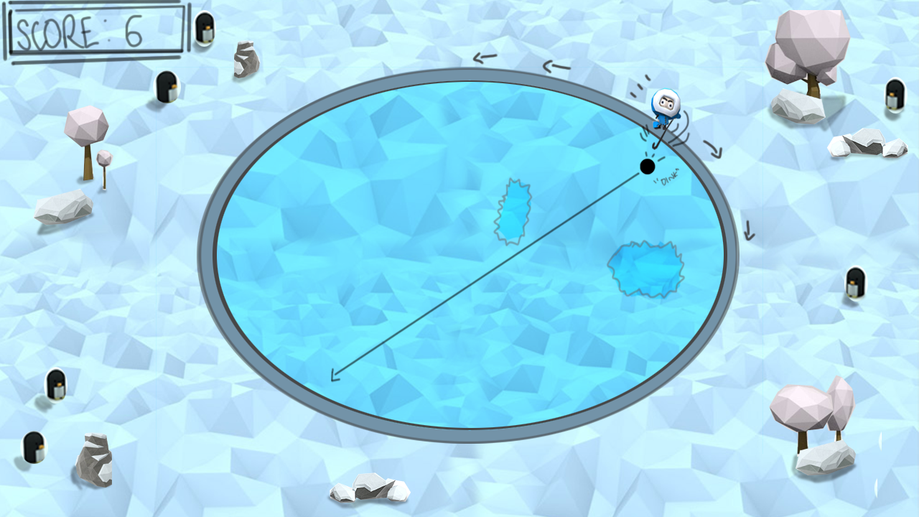
Antarctichill
A game where an Eskimo bounces a puck around an ice rink, keeping it in bounds for as long as possible, all whilst obstacles hinder their progress.
Solo hockey
Pong balancing act
Relaxing, cool aesthetic

Slide 9
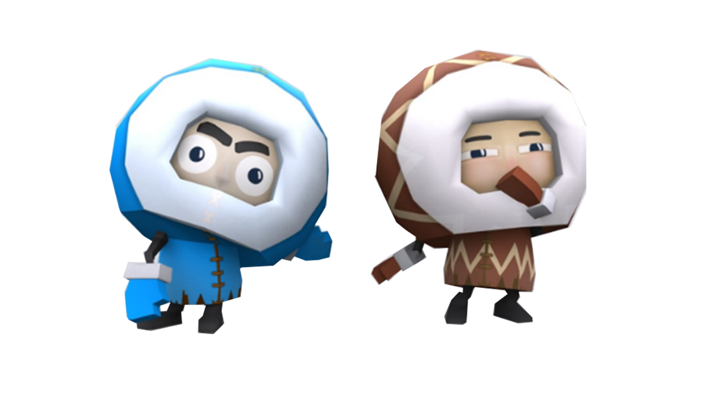

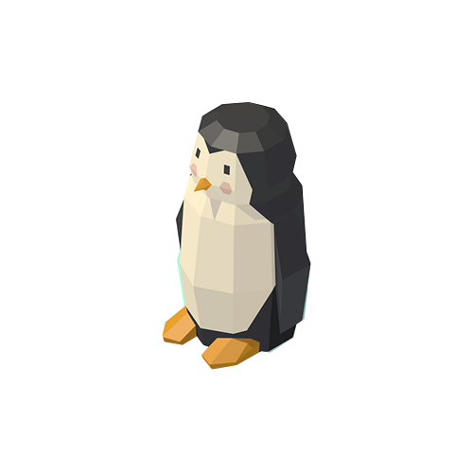
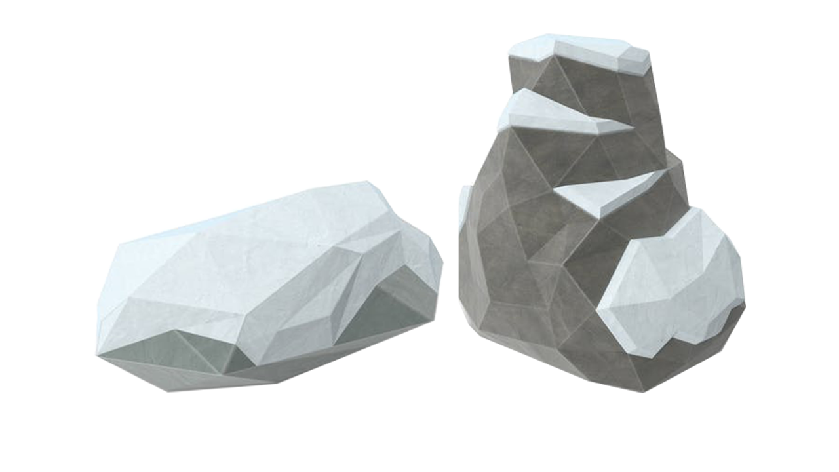
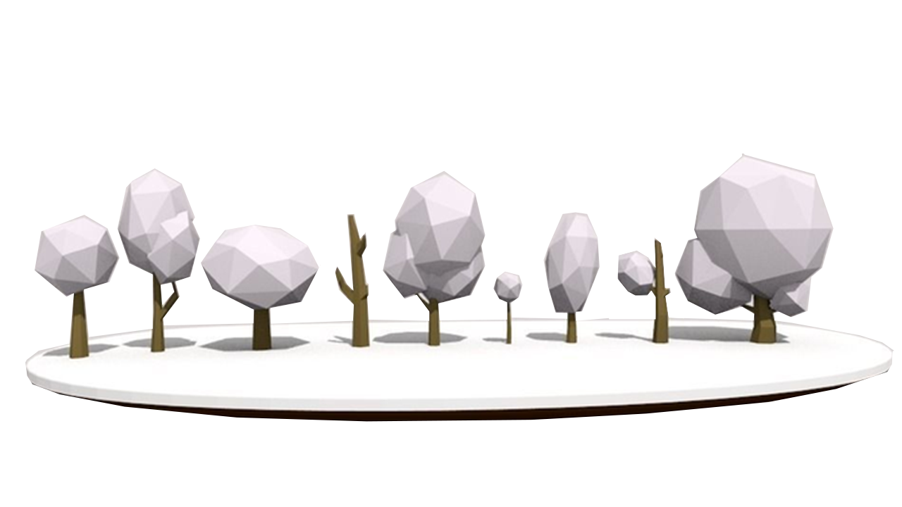
Antarctichill – Art direction
Stylized, low-poly; Two-tone shading, hand-drawn textures. Subtle fog effect to give a soft feel. Slow/graceful animations for ice skating
Concept art proposed for environment / character / props - low poly 'blocky' Character, assets & environment
Colour palette – cool, 'wintery' tones (light blues, whites), pastel colours
Art tools software – Maya, Zbrush, Substance Painter/Designer, In-engine lighting

Slide 10

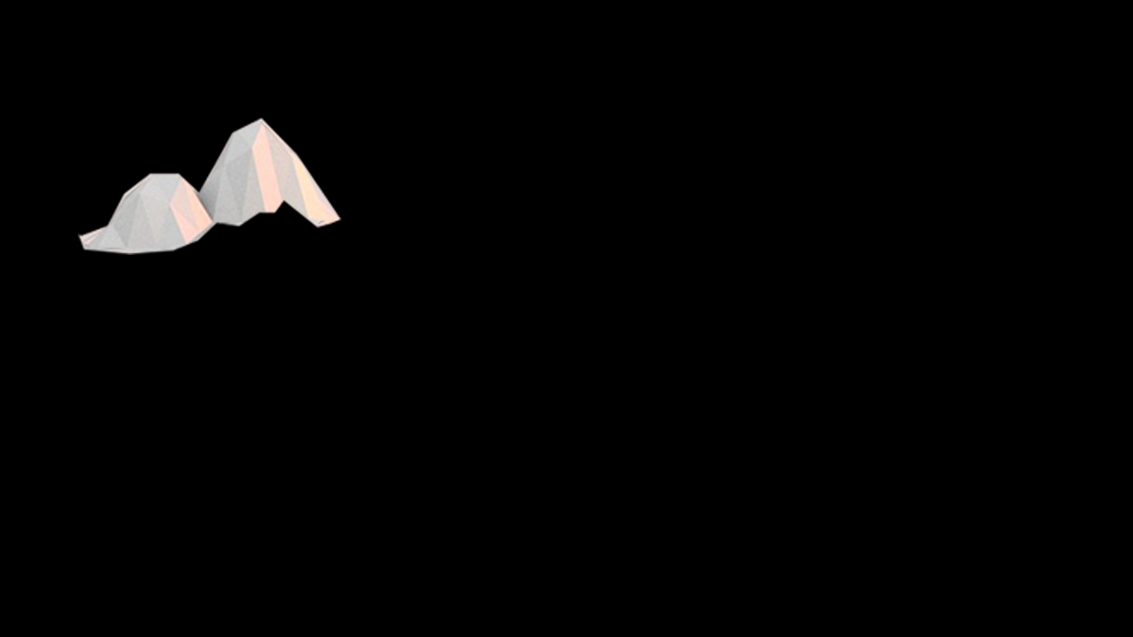

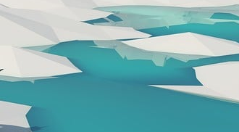
Antarctichill – Game design
Gameplay Pillars
Casual solo gameplay
Gameplay Features
Time-compounding score, obstacles alter puck trajectory
Gameplay Systems
Paddle rotating around the map randomly spawning obstacles
Obstacles -
Patches of snow
Melting Ice
Fireballs
Penguins

Slide 11
Antarctichill – Technical Information
Engine
Unity
Platform
Web
Mobile(potentially)
Technical challenges
Frost graphic EFX
Triggering animation
Ball Physics (bouncing on curves / objects using a custom physics engine)

Slide 12
Project schedule
Week 2- Playable prototype
Week 4- All features implemented
Week 6- Polished and submitted

Slide 13
Conclusion
Pond Chicken, 2 frogs leap with paddles, trying to hit the other with a pea, in a chaotic kitchen.
Antarctichill, where a lone eskimo whacks a puck in an ice rink, avoiding obstacles, and keeping it inside the circle for as long as possible.

